Slide 1
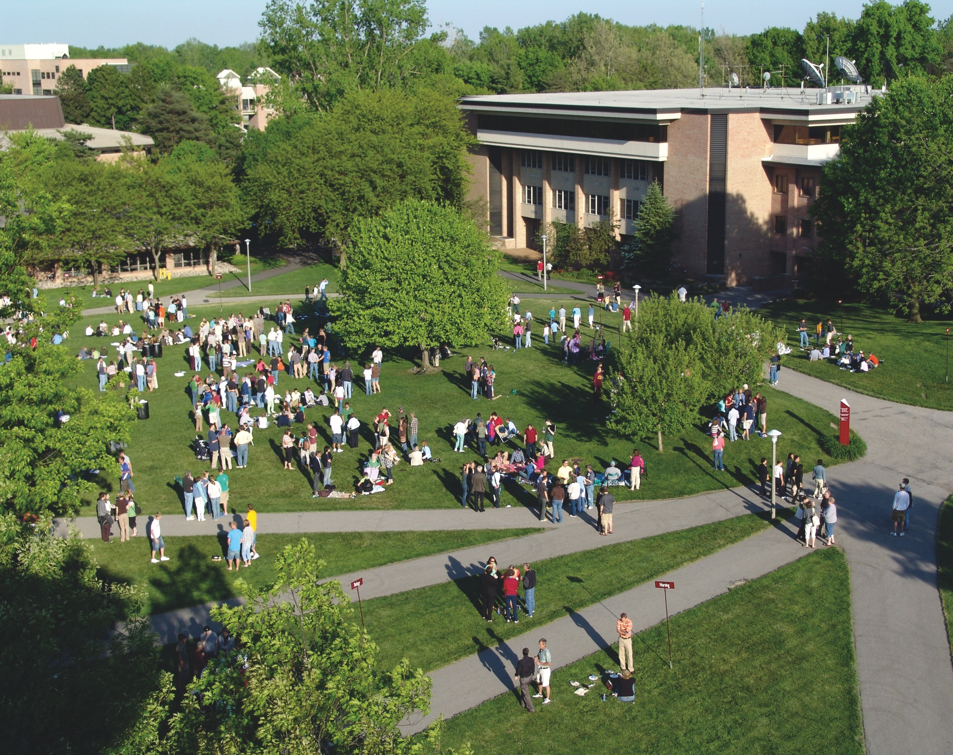
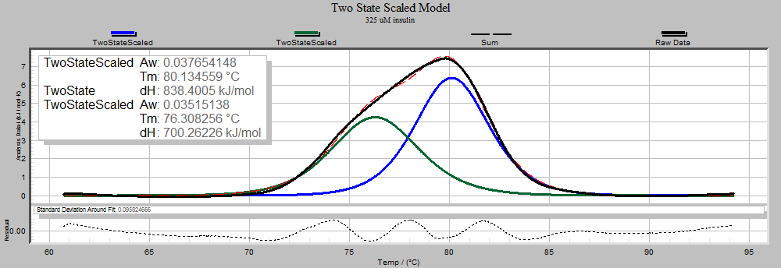
Title of Poster
Author, UNC Charlotte
Adviser’s name, Department
Introduction
Method
Results
This is a 32 x 40 template that you can use to organize your research poster. You can revise the template as need and moved columns around.
How much text should be in the poster? If there’s too much text the readers will lose interest and move on. Limit your text to the bare minimum and give more detailed information in a handout to interested viewers.
If possible use bullet points and phrases over whole paragraphs. One source suggested a maximum of 800 words.
Font sizes: Make the section titles about 48 point text. The body text of a poster should be about 24-36 point.
Columns
The columns are there for a guideline. You do not have to use them.
Background Color
To choose a background other than this “GRAY” look: choose Format > slide background / fill then click on desired options and apply.
Scans and Digital Photos
Scans images the size you want them in the poster at 180 dpi. For pictures from your own digital camera, uses the largest file setting.
View your poster at 100% to see if your photos are high enough resolution.
Inserting photos:
To insert a photo choose Insert menu/picture
If you insert graphics from a Microsoft Office product please include a copy when sending the poster. Occasionally I have trouble with the graphics and it helps to have the original documents
Inserting Excel Charts
Select the chart in Excel. Copy it (edit menu/copy). Return to PowerPoint. Paste it. (edit menu/paste).
Caption for your photo
Conclusions
Printing
After you finish your poster, edit it and double check for spelling and grammar. You need to save your file as a PDF file. Then email your poster to: repros@uncc.edu or deliver your file to Repros on a USB drive. Allow one week for printing. Include any graphics, photos or fonts in a folder in case Repros needs to re-insert anything. Please indicate whether you worked on a Mac or PC to design your poster.
Saving
When finished with your poster, also save it as an Acrobat file (.pdf). Please make sure we have copies of both files.
Objectives
Collected Data
About Backgrounds…
Contrast is important. If your background is dark use white text and make everything bolder. Thin lines will have to be thicker. Fonts that have thin letters might be better bold or in a sans-serif font.
Avoid a “busy” background. It’ll make the text harder to read. Filling a background with a photo is cool but it can easily compete with your information.
If the text doesn’t stand out from the background edit the text block to have a background color. Select the textbox then choose Format Menu / shape/fill: color. Or just put a color box behind the text.
To add an additional heading just copy and paste an existing heading and edit its text.
About Pictures . . .
Unless you find photos made for down-loading and printing, the resolution is likely to be too low. The photos will not print well.
Only use internet photos with copyright permission. We recommend a stock photography site such as istockphoto.com. You will pay a small fee but have much higher quality images.
If you use a photo for the poster background don’t use a busy, detailed image. It could distract from the text of the poster. The image must be high resolution. A textured background or gradient fill may be a better background option.
description of this figure
 | Anxiety | Depression
Physiological | -“Anxiety is so physical” -“Thought I was having a heart attack” -Rapid breathing -Sweating palms -Can’t sleep -Nausea | -Tired -Exhaustion -Loss of appetite
Cognitive | -Racing thoughts | -Downward spiral -Lack of motivation -Pessimism -Worthlessness -Suicidal thoughts
Behavioral | -Restlessness - Can’t sit still -Nail biting -Hair pulling -“You do anything to get rid of it” | -Tearfulness -Isolation -Poor personal hygiene
Affective | -Desperation -Fear -No peace -Urgency | -Sadness -Darkness -Hopelessness
References
description of this figure
Lastname, J. M., & Witte, K. L. (1988). Lasdkjf ;klj sdfkl jlk;jsdf lk;sjdf klj. Bulletin of the Society, 12 (4), 325-328.

